Slide 1
PMG 4101: Project Management
Syed Samin Sadaf
Lecturer
Department of CSE,
United International University (UIU)

Slide 2
Software Methodology

Slide 3
Software Methodology
Software Methodology means a proper, organized way to develop software from start to finish.
It is like a recipe for cooking or a blueprint for building a house.
It tells the team:
What steps to follow
When to do each step
How to plan the work
How to communicate
How to test the software
How to deliver it
Without a methodology, software development becomes messy, confusing, and risky.
So, a methodology gives a step-by-step path to follow

Slide 4
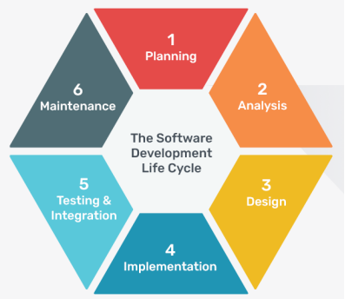
Why is Software Methodology Important?
Ensures Organized Development: A methodology makes sure everyone follows the same process, so work doesn’t become chaotic.
Reduces Errors and Rework: Because tasks follow a clear plan, mistakes are found early and fixed quickly.
Improves Team Communication: Everyone knows what to do, when to do it, and what others are doing.
Helps Understand User Needs Better: Some methodologies focus on collecting customer feedback early.

Slide 5
Why is Software Methodology Important?
Saves Time and Cost A disciplined process avoids unnecessary work and delays
Improves Software Quality Methodologies include stages for testing, review, and correction.
Makes Maintenance Easier Good documentation and structure make future updates simple.

Slide 6
Common Software Development Methodologies
Agile Methodology
Waterfall Methodology
Rational Unified Process (RUP) Methodology
Spiral Methodology
Scrum Methodology
eXtreme Programming Methodology
Boehm’s Spiral Methodology

Slide 7
Common Software Development Methodologies
Incremental Software Development Methodology
DevOps Methodology
Rapid Application Development Methodology
Dynamic Systems Development Methodology
Prototype Methodology
Feature-driven Development Methodology
Joint Application Development Methodology

Slide 8
Agile Methodology

Slide 9
Agile Methodology
Agile is a modern, flexible, and iterative approach to software development that focuses on:
delivering working software quickly
involving customers continuously
adapting to requirement changes
improving the product step-by-step
Agile develops software in short cycles called Sprints, usually lasting 1–4 weeks.

Slide 10
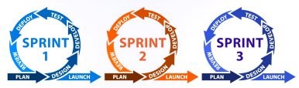
Agile Methodology
Key Idea:
"Deliver small, deliver fast, get feedback, improve continuously."
Agile methodology is arguably one of the most popular software development methodologies in recent days. It takes a different approach from the conventional, linear method. Agile focuses on how to satisfy the users instead of emphasizing documentation and rigid procedures.

Slide 11
Advantages of Agile
✓ Software has minimal defects due to the iterative effort in testing and fine-tuning.
✓ Clarity between team members during development, thanks to the frequent and transparent development.
✓ Changes in project requirements are easily addressed and work on with little impact on the timeline.
✓ An overall improvement on the deliverable quality.

Slide 12
Disadvantages of Agile
🚫The team can sometimes lose focus due to overwhelming change requests.
🚫Documentation takes a back seat in Agile, which can be a problem later on in development.
🚫Agile focuses on discussions and feedback, which can be too time-consuming for the team.
🚫Due to its non-structured approach, Agile requires experienced developers who can work independently.

Slide 13
When to use Agile
Requirements are uncertain and evolving
Projects needing early and frequent delivery
High customer/stakeholder involvement
Complex projects with many unknowns
Dynamic, fast-changing markets
Cross-functional teams are available

Slide 14
When NOT to use Agile
Requirements Are Fully Known and Fixed If nothing is expected to change, Agile’s flexibility adds unnecessary overhead.
The project requires strict documentation or compliance Industries with heavy regulatory requirements (healthcare, aerospace, finance) may need Waterfall-style documentation.
Stakeholders are not available or engaged Agile needs constant feedback. If feedback is slow → sprints fail.
Large, geographically distributed teams without collaboration tools Agile requires tight communication. Distributed teams without strong collaboration struggle.

Slide 15
When NOT to use Agile
Very short, simple, or one-time projects If the work is small and predictable, Agile ceremonies (standups, sprint planning) add unnecessary overhead.
Teams lack agile experience If the team doesn’t understand Agile principles, the process will collapse.
Fixed budget, fixed scope, fixed deadline projects Agile handles flexibility, but if everything is fixed, Agile’s value is limited.

Slide 16
Waterfall Model

Slide 17
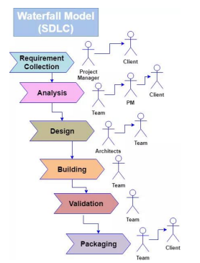
Waterfall Model
In Waterfall methodology, developers complete one stage in its entirety before beginning the next.
Each stage has its own requirements and plan and is reliant on inputs from the previous stage.
In this way, the development flows from one stage to the next, and there's no overlap of work between any two stages.

Slide 18
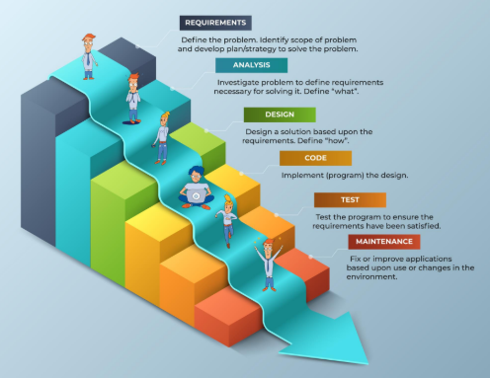
Waterfall Model

Slide 19
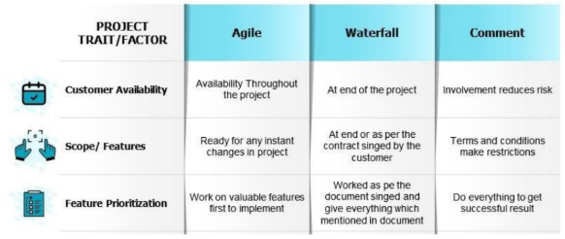
Waterfall vs Agile

Slide 20
Advantages
✓ The linearity of the waterfall model makes it easy to understand, particularly for new developers.
✓ All specifications and deliverables are spelled out before the development commence.
✓ There’s no room for miscommunicating information with the waterfall model as it’s clearly defined in each stage.

Slide 21
Disadvantages
🚫It doesn’t include customer feedback in the early phases, which increases the risk of the project veering off target.
🚫Testing is only executed at the end of the development. Some problems are harder to fix at a later stage.
🚫The rigidity of the waterfall model gives no room for changes, making it unsuitable for complex projects.
🚫The team can spend too much time on documentation instead of delivering solutions that solve the user's problems.

Slide 22
When to choose Waterfall?
Use waterfall only when you have a project with clearly-defined scope. It is not suitable for development that involves many unknowns. Waterfall is ideal for projects with predictable outcomes and when you have a team of inexperienced developers.
Requirements are clear and stable
Project scope is well-defined from the beginning
Technology to be used is well understood
Changes are expected to be minimal
Project is small or moderately complex
Strong documentation is required
Regulated industries (e.g., government, healthcare, banking)
Teams are working sequentially where each phase must finish before the next begins

Slide 23
When NOT to choose Waterfall?
Requirements are unclear or likely to change
Frequent client feedback is needed
Project requires rapid iterations or prototypes
Technology is new or experimental
Large or highly complex projects with uncertainty
Customer wants continuous delivery of features
Market conditions may change during development
Projects requiring high flexibility

Slide 24
Hybrid (Agile + Waterfall)
Sometimes using both makes sense:
Scenario
A banking project with strict regulatory requirements (needs Waterfall).
But front-end features can evolve based on user feedback (needs Agile).
Approach
Requirements + architecture = Waterfall
UI development + enhancements = Agile
This hybrid approach is common in large organizations.

Slide 25
Any Questions?

Slide 26
Acknowledgement
Slide Courtesy:
Dr. Suman Ahmed, Professor, CSE Department, UIU

Slide 27
Thank You!

